Slide 1
TT231 – DevOps Process demonstration
11 October 2019

Slide 2
Agenda
Key Objectives of DevOps
TT231 DevOps process & components
TT231 GitLab Project Setup
Developer Environment
TT231 DevOps process & components explanation
Pending works for DevOps setup
Discussion & feedbacks

Slide 3
Key Objectives of DevOps
Quicker
Deployment
Cycles
Faster
Innovation
Cycle
Increase In
Product Quality
Reduction in
Suspension of
Operations
Notes:
Quicker Deployment Cycles: (Automation) Development -> Feedback -> Commit -> Testing -> Deployment
Increase In Product Quality: (Automation) of
testing,
source code quality checking,
faster feedback to developers,
better monitoring of deliverying works
Faster Innovation Cycle:
Automation
Lesser overhead between development processes, such as quality check, deployment etc.
Reduction in Suspension of Operation:
Automation of IT operations, such as deployment etc.
- Faster publications and a smarter way to work
- Accelerate resolution time.
- Better management of unforeseen work.

Slide 4






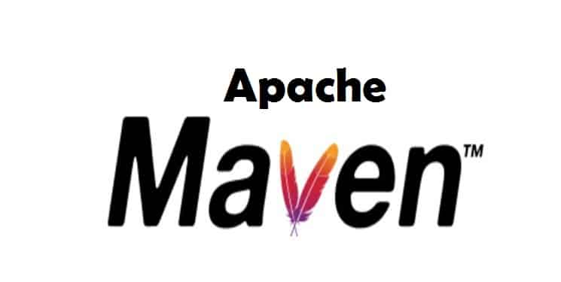



TT231 DevOps process & componentS
Versioning Control Process
Source Code Quality Process
Dependency Handling
CI/CD Automation
Issue Tracking
Deployment Automation
Notes:
Versioning Control Process
Using GitLab EE
Development process is defined to ensure proper process and rules are followed
Source Code Quality Process
Automatically scan code for developer
Recommendation to developers for better quality code
Live feedback on developer tools to guide developers when mistakes are made (active prevention)
Dependency Management Process
Ensure dependencies for i-transport 2.0 are properly managed and always referring to the correct library
Non-public software library can be properly managed
Internal release & distribution management
CI/CD Automation
Continues Integration & Continues Development
Testing, compilation, deployment can be automatically handled
Issue Tracking
SSA use JIRA
Tracking of the issues reported
seamlessly updates of JIRA tickets status
**To be further work on
Deployment Automation
Compilation & deployment can be automated when everything is good

Slide 5
TT231 GitLab Project Setup
http://10.180.11.144/i-transport-2. 0

Slide 6
Developer Environment

Slide 7

TT231 DevOps process & components explanation
Versioning Control House Rules Overview
5 type of Branches
Master (Permanent)
ALWAYS Production Code
Only check in from Release
Release (Permanent)
For developers to work together and consolidating all the code before release
Code stay here before deployed to production (then merge into Master)
Develop (Permanent)
For developers to work together on all the unreleased changes/features
Features
A features per branch
To be removed after merge into development
Can only merge into Development
Prefix of “feature_”
Hotfixes
A fixes per branch
For issues that required faster/immediate solution to production / testing
Can only merge into Development
Prefix of “hotfix_”

Slide 8
TT231 DevOps process & components explanation
Versioning Control House Rules Overview
Local Changes
Commit
Push
Raise merge request
Ok?
Prepare for Release
master
V1.0.2
release
development
feature_mainpage
feature_websocket_dev
Check in EVERYDAY before you leave (commit & push to remote git server)

Slide 9
TT231 DevOps process & components explanation
Source Code Quality Process
Dependency Management
Developing
Commit to Branch
Releasing
Quality Ok?
Failed.
Feedback on
code quality.
TT231 Artifacts Repository
Public Artifact Repository
1.) Get depending library
Offline retrieve, scan, deploy
Dependent Libraries
Compilation Trigger
Dependent Libraries
2.) Compile
Application
3.) Release internally for internal referencing

Slide 10
TT231 DevOps process & components explanation
Proposed CI/CD Process Overview
Developed
Released
Deployed
master
V1.0.2
release
development
feature_mainpage
Features accepted.
Tested.
AFTER Release deployed to Production & DR env.
Developer released.
CI/CD automatic compile and release to dev env.
Ready for client testing
CI/CD automatic compile and release to UAT env.

Slide 11




Pending works for DevOps setup
SSA Task Management & TT231 GitLab Integration
Deployment Integration (Last step of CI/CD)

Slide 12
Discussion & feedbacks

Slide 13
End
Restricted

